Slide 1

From Prosecuted to Job Recruited: An Exploratory and Machine Learning Approach to Employment after Prison
Mariel Alper, Patrick McLaughlin, Kevin Patrick, Rebecca Weaver, Jon Sperling
Preliminary Draft - Do Not Cite

Slide 2
Employment after Prison
Estimated that more than 6 million working-age people are former prisoners (CEPR, 2016)
Incarceration reduces employment and earnings (Holzer et al., 2003; Pager, 2003)
Barriers from limited skills, poor health, race, area of residence, lack of employer willingness to hire former prisoners (Holzer et al., 2003)
Employment reduces recidivism but may be selection effects, recidivism reduction may be greater for older offenders (Uggen, 2000)
Employment may also generate income, enhance social supports, and reduce reliance on public assistance
Preliminary Draft - Do Not Cite
Notes:
Prior research has identified the benefits of employment after imprisonment. Employment
can generate income, enhance social supports, and reduce reliance on public assistance.
Employment following incarceration has also been shown to reduce recidivism. Interventions
such as education programs, employment readiness programs, technical training programs,
and assistance in finding jobs can increase employment. However, resources to provide
these programs are limited and are best targeted at prisoners whose employment status
would be improved by the intervention. Those prisoners who will be employed regardless
of employments interventions would not benefit further from this type of programming.
Prisoners who are unlikely to be employed may benefit more from interventions that target
other underlying barriers rather than employment interventions.
DOC: reduce recidivism
Tax payer: reduce costs of incarceration due to decreased recidivism and use treatment resources effectively
Constituency: improve ability to generate income, enhance social supports

Slide 3
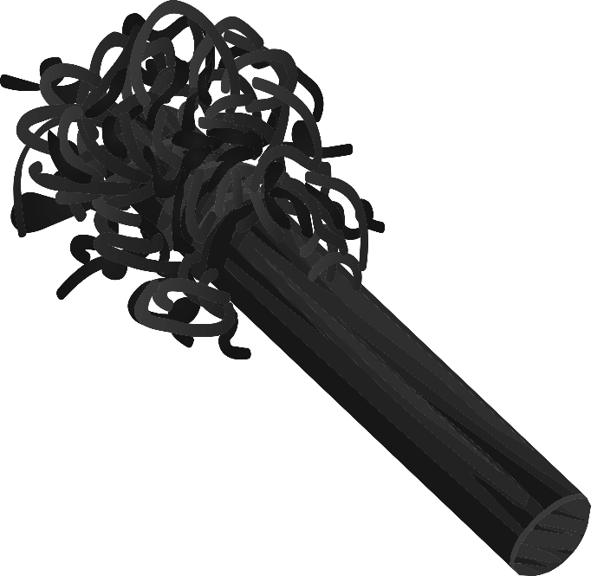
Risk principle of effective intervention
Using scarce correctional treatment program resources on low-risk offenders that do not need them is a poor use of resources
Placing low-risk offenders in more intense programs may have adverse effects (Latessa and Lowenkamp, 2005)
Preliminary Draft - Do Not Cite

Slide 4

Research Questions
What are the employment patterns of former prisoners over two years following release?
What are the characteristics of former prisoners who are employed and unemployed?
Which prisoners should receive priority for interventions that can increase or enhance employment opportunities after release?
Preliminary Draft - Do Not Cite

Slide 5
Data
Data sources:
Illinois Department of Corrections (ILDOC) data on exits from prison (1990-2015)
Illinois Department of Employment Security (IDES) quarterly wage data (2005 to 2015)
Cohort: All exits from prison from 2010 through 2013
More recent data was better quality
Job market changes over time
89,580 unique individuals exited prison during this timeframe
Followed cohort for 2 years (8 quarters) after prison release, including the quarter of release
Preliminary Draft - Do Not Cite
Notes:
Datasets used:
IDOC exits – Detailed transactional data of each time an inmate was released from an Illinois Department of Corrections from 1990 to 2015
IDOC exits – data collected using correctional facility data and court records
IDES wages – Quarterly records of wages for every job held by each person in the state of Illinois from 2005 to 2015
IL wage – data derived from the IL Department of Employment Security (IDES) Unemployment Insurance (UI) wage file that the Local Employment Dynamics (LED) state partners supply
Subsetted IDOC exits to exit years of 2010 through 2013 to alleviate data concerns. More recent data is likely to be of higher quality. Also, the depression was just prior so people were more likely to get jobs and give us more information for predictives.
This gave us our cohort of 89,580 unique individuals who exited prison.
Followed our cohort for 2 years (8 quarters) after prison release, including the quarter they were released in: quarter of release + 7 subsequent quarters
Some people released at the beginning of the quarter so have sufficient time to work, others released at the end of the quarter so less time to gain employment during the quarter of release
to the Census department for use in producing Quarterly Workforce Indicators (QWI)

Slide 6
Data
Merged quarterly wage data to prison exit data
Removed ex-offenders with more than 30 unique jobs in any one quarter.
Removed ex-offenders with quarterly wage > $100,000
These removals were a minimal amount of our overall group
Many cases with more than one record per person-quarter
May have multiple jobs
Totaled all wages for each person/quarter and kept the employer associated with the largest wage.
Preliminary Draft - Do Not Cite
Notes:
Found that many SSNs have far too many wages in an individual quarter, which led us to believe it was a SSN shared by multiple people. A good break point in the data was to remove all wage data when a SSN had 30 or more individual wages in any given quarter.

Slide 7
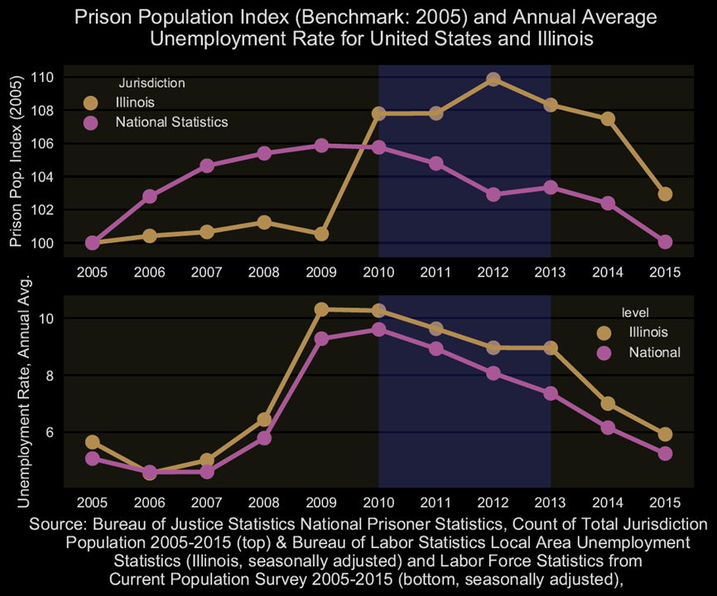
Preliminary Draft - Do Not Cite
Notes:
Prison population in Illinois increased in 2010 and remained above the national rate
Unemployment in Illinois mirrored the national rate, remaining slightly higher throughout the time period. Like the national rate, the rate in IL increased after 2007 and decereased after 2010. During our follow up period, unemployment decreased.

Slide 8
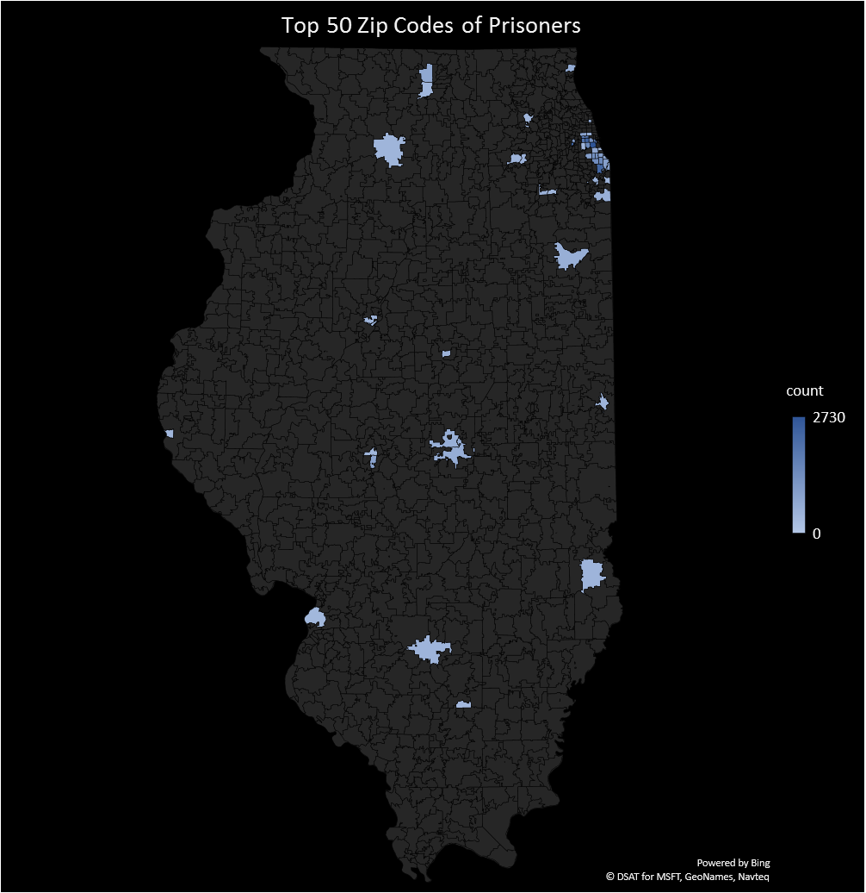
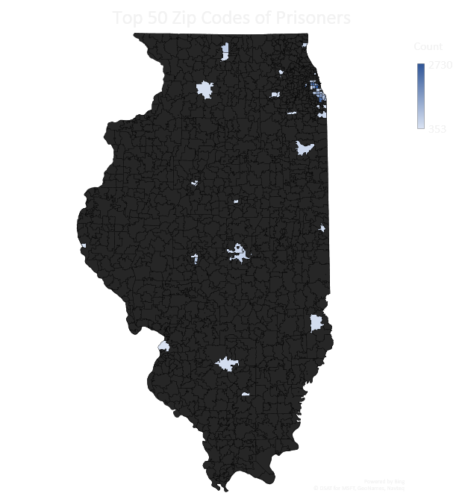
Preliminary Draft - Do Not Cite
Notes:
Characteristics of the prisoners varied by geography: cocaine use and employment prior to imprisonment was more common outside of Chicago, and gang membership was more common in Chicago
Top 50 ZIPs represent 19.3% of total 2010 pop in IL. Chicago ZIP pop about 67.5 percent of the 50 ZIPs.

Slide 9
Research Question #1
What are the employment patterns of former prisoners over two years following release?
Preliminary Draft - Do Not Cite

Slide 10
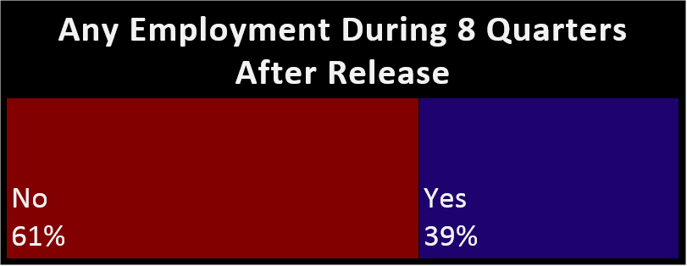
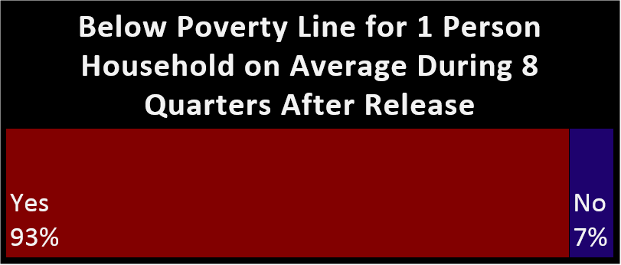
Preliminary Draft - Do Not Cite
Notes:
Illinois
2010: 13.8% below poverty
2011: 14.9%
2012: 14.7%
2013: 14.6%
Nationally in the 15%s
(source: Census)

Slide 11
Most Common Employment Patterns
Quarter of release
Q 0 | Q1 | Q2 | Q3 | Q4 | Q5 | Q6 | Q7
 |  |  |  |  |  |  |  | 61.3%
 |  |  |  |  |  |  |  | 3.5%
 |  |  |  |  |  |  |  | 2.6%
 |  |  |  |  |  |  |  | 1.8%
 |  |  |  |  |  |  |  | 1.5%
 |  |  |  |  |  |  |  | 1.3%
 |  |  |  |  |  |  |  | 1.2%
 |  |  |  |  |  |  |  | 1.2%
 |  |  |  |  |  |  |  | 1.0%
 |  |  |  |  |  |  |  | 1.0%
 | Unemployed
 | Employed
n=89,580
Preliminary Draft - Do Not Cite
Notes:
Most common pattern was no employment over the 8 quarters (61.3%)
Second most common was employed for all 8 quarters (3.5%)
Etc.

Slide 12
 | Employed Persons
 | Mean Quarterly Wage
Release quarter | $2,850.88
Quarter 1 | $3,021.18
Quarter 2 | $3,412.74
Quarter 3 | $3,632.26
Quarter 4 | $3,801.64
Quarter 5 | $3,947.57
Quarter 6 | $4,047.96
Quarter 7 | $4,122.07
Preliminary Draft - Do Not Cite

Slide 13
Research Question #2
What are the characteristics of former prisoners who are employed vs. unemployed?
Preliminary Draft - Do Not Cite

Slide 14
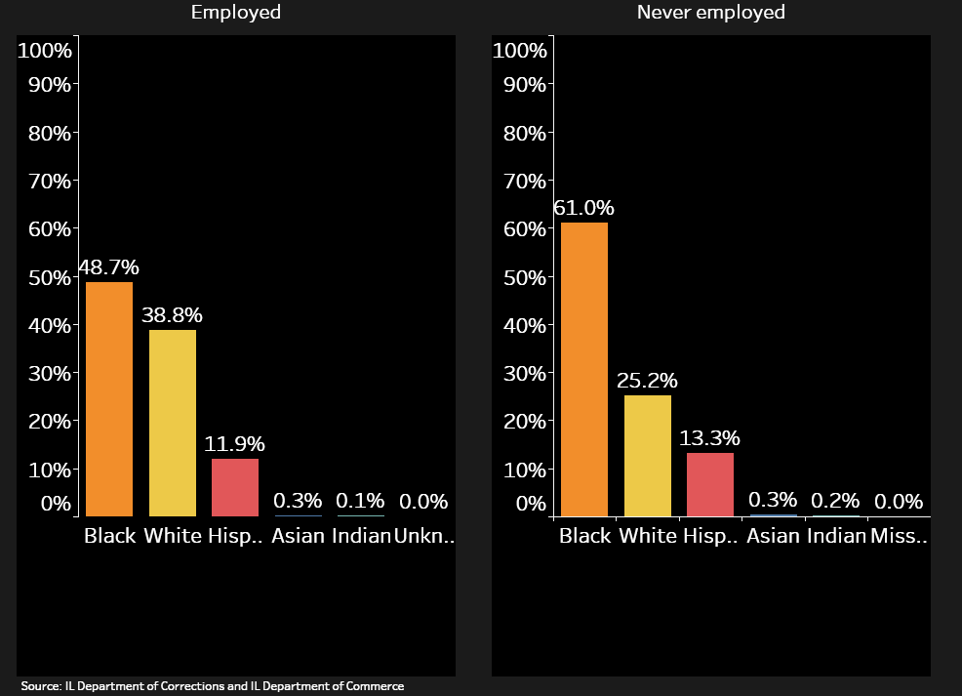
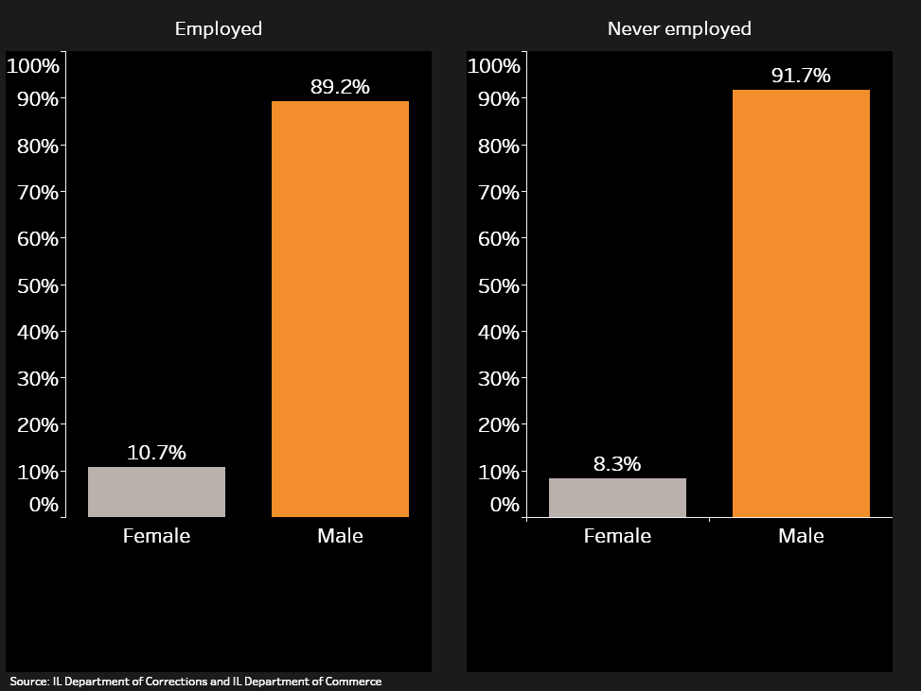
Employed former prisoners more likely to be white or female
Race
Sex
Preliminary Draft - Do Not Cite
Notes:
Employed prisoners were more likely to be white and female

Slide 15
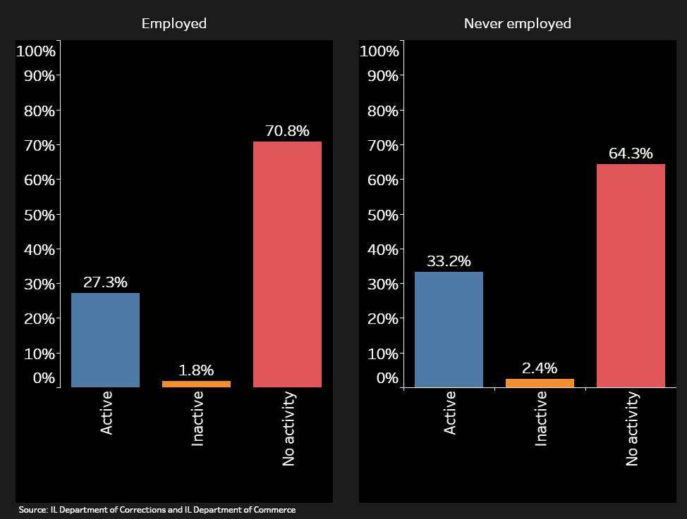
Employed former prisoners less likely to be in a gang
Gang activity
Preliminary Draft - Do Not Cite
Notes:
Nearly half (43%) of prisoners were admitted directly from the court (i.e. new charge)
Those who were employed were less likely to have been admitted due to a technical violation
Employed prisoners were less likely to be in a gang

Slide 16
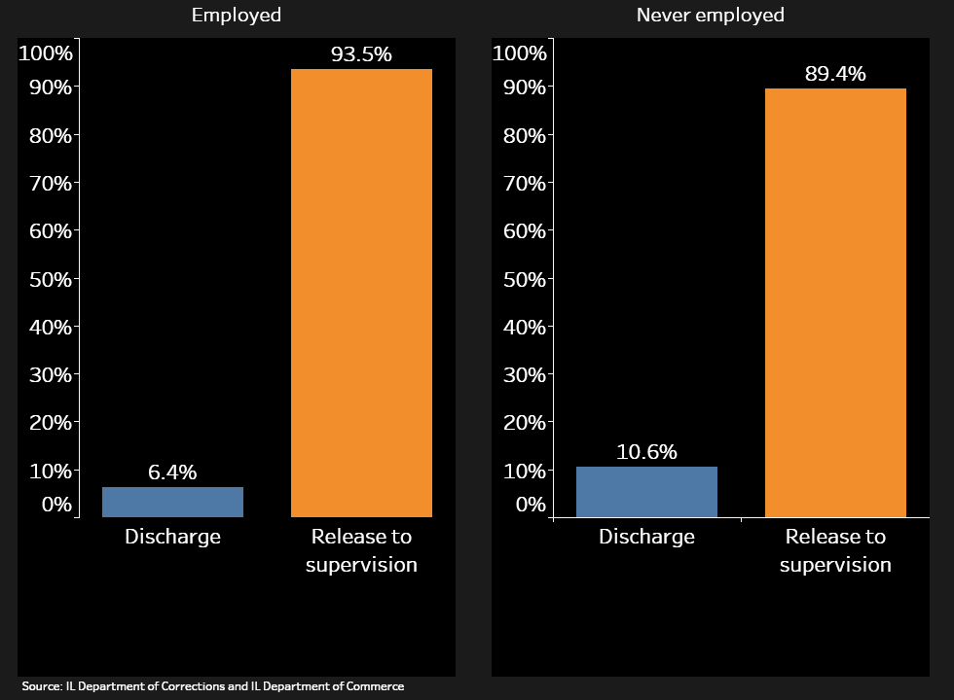
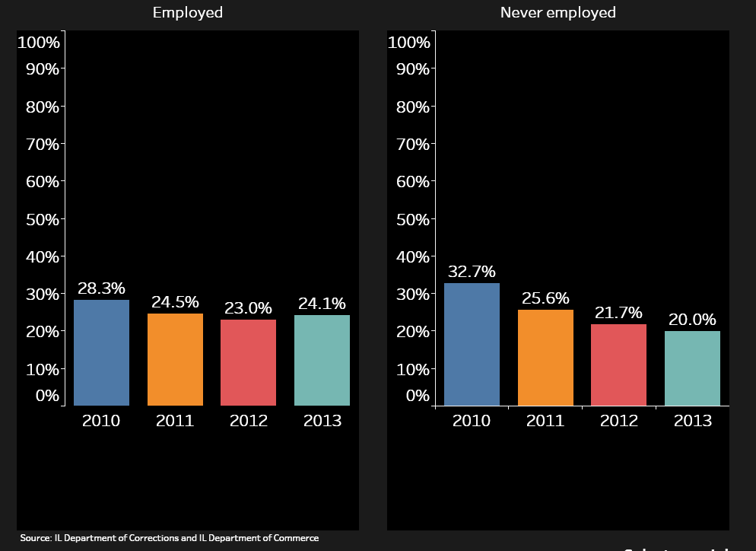
Employed former prisoners more likely to be released to supervision or released in later years
Release type
Release year
Preliminary Draft - Do Not Cite
Notes:
Employed prisoners are more likely to be released to supervision and released in later years
(State-wide and national unemployment lower in later years as well)

Slide 17
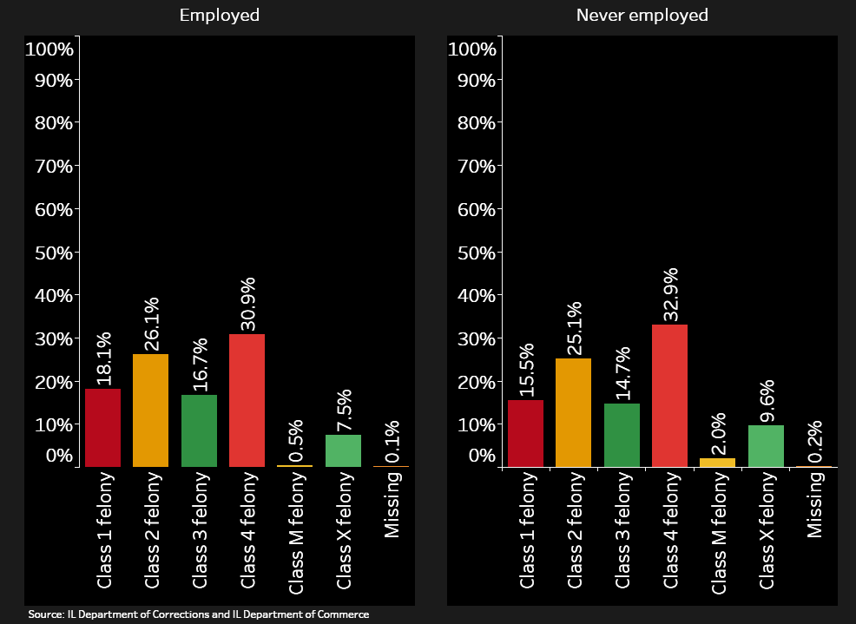
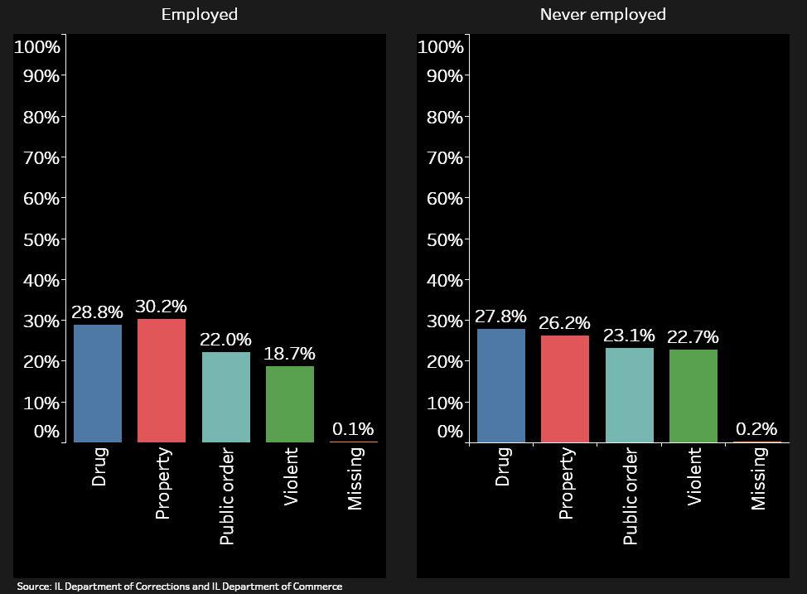
Employed former prisoners less likely to be in prison for the most serious offense types or a violent crime and are more likely to be in prison for a property crime
Holding class
Offense type
Preliminary Draft - Do Not Cite
Notes:
Prisoners who were employed were more likely to have a more serious class felony, except those who were employed were less likely to be in prison for the most serious types (murder, and class X which is the most serious short of murder)
Employed prisoners are more likely to be in prison for a property crime and less likely to be in prison for a violent crime

Slide 18
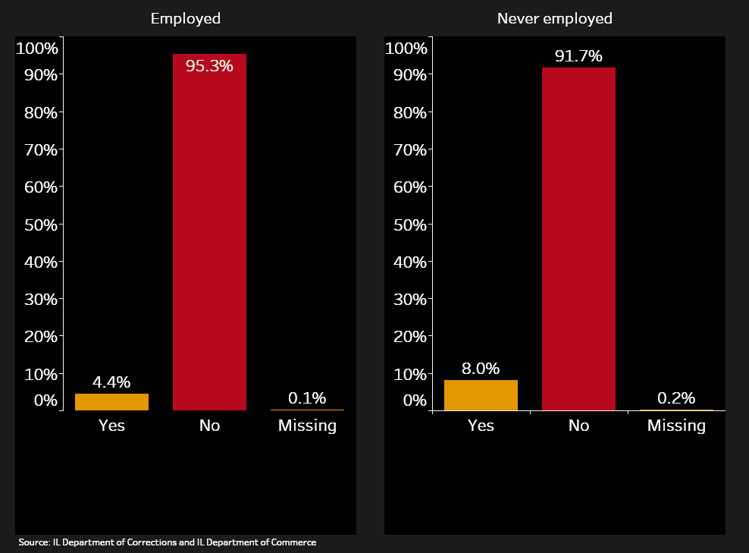
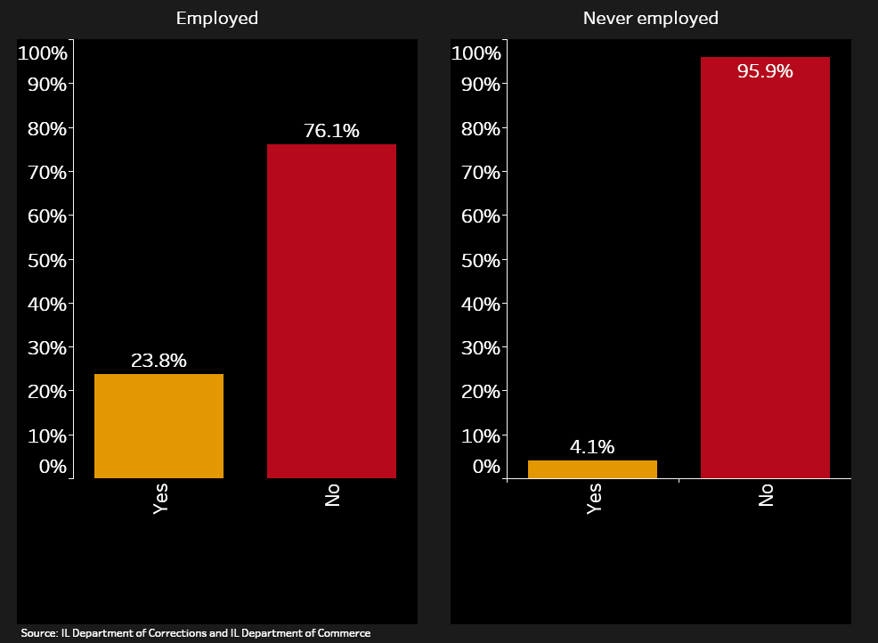
Employed former prisoners less likely to be in prison for a sex offense and more likely to have been employed in the quarter prior to imprisonment
Holding offense sexual
Employed prior to imprisonment
Preliminary Draft - Do Not Cite
Notes:
Employed prisoners are less likely to be in prison for a sex offense
Employed prisoners were more likely to be employed in the quarter prior to imprisonment

Slide 19
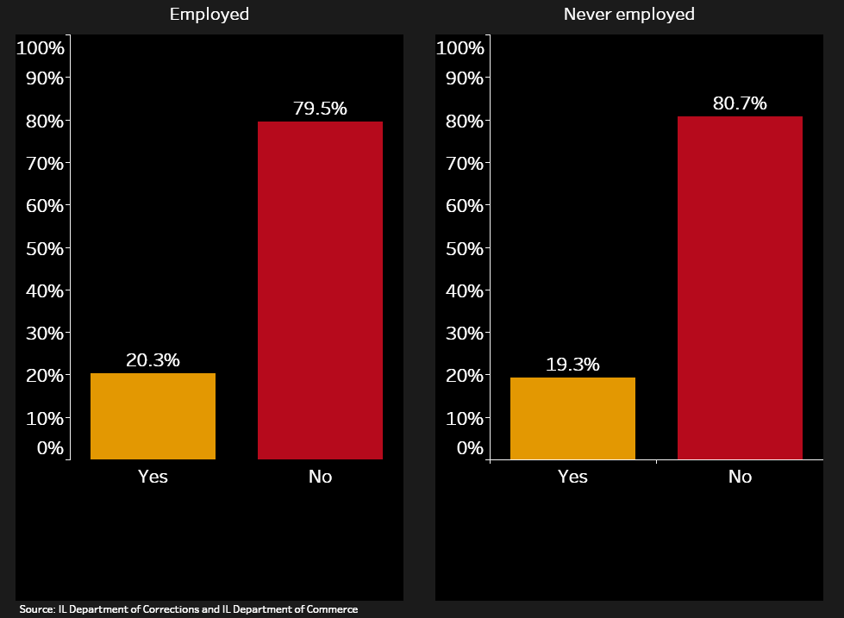
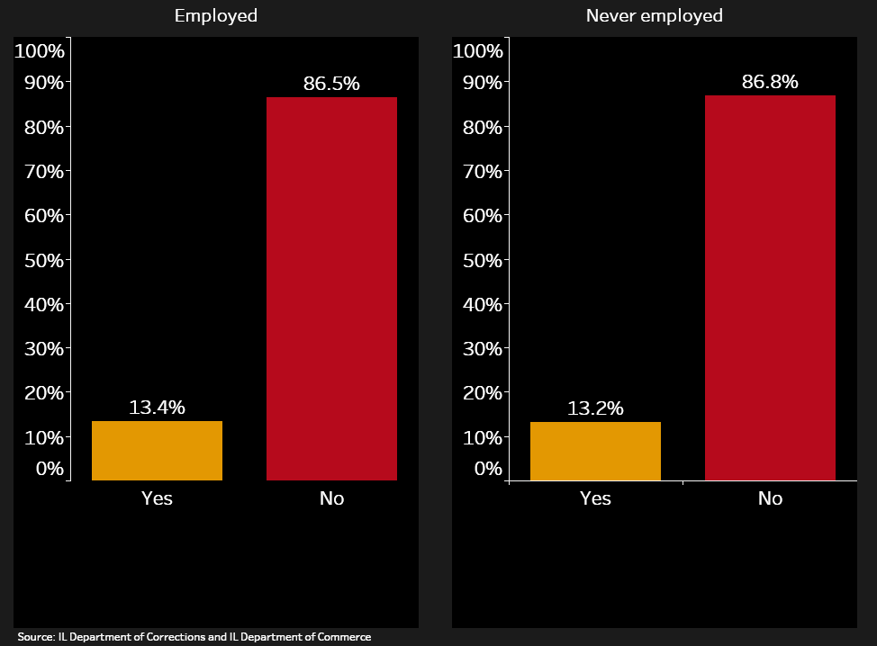
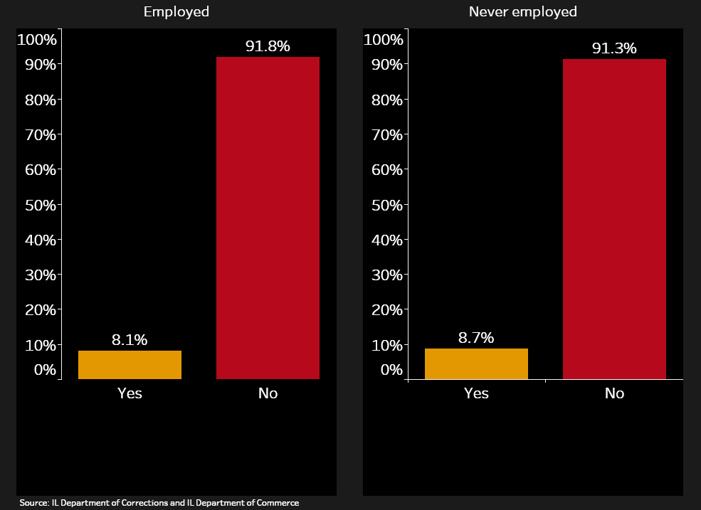
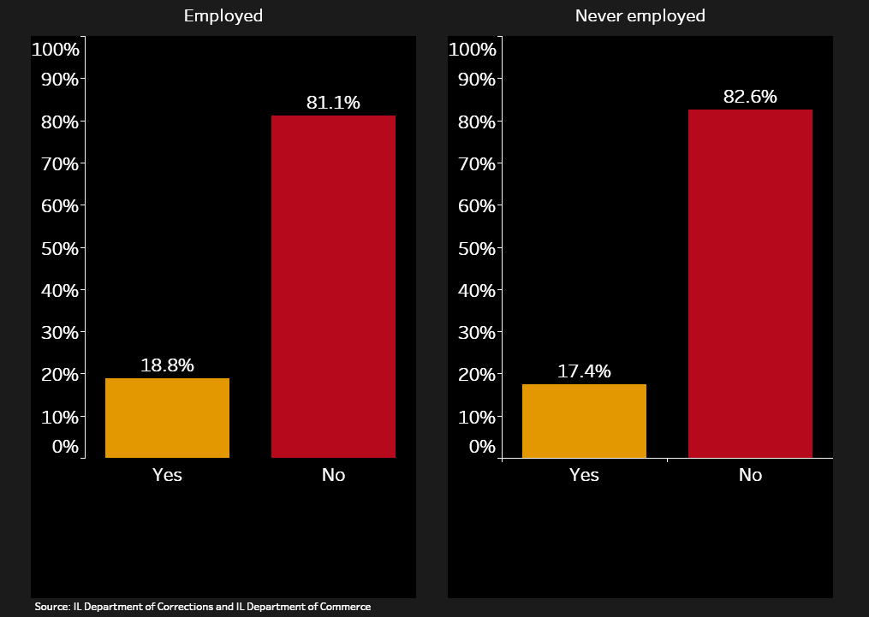
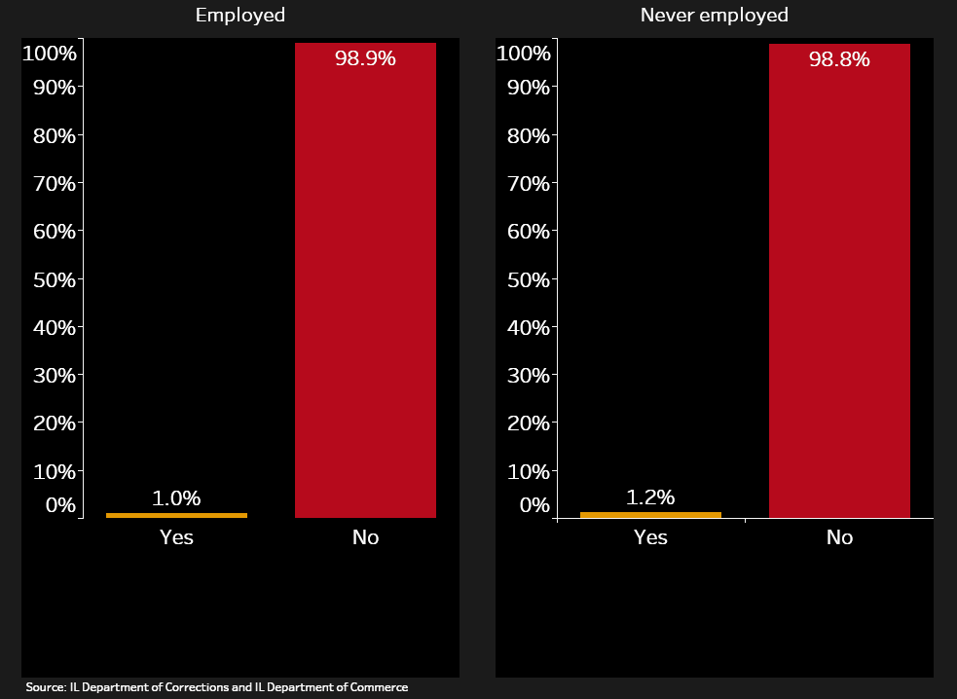
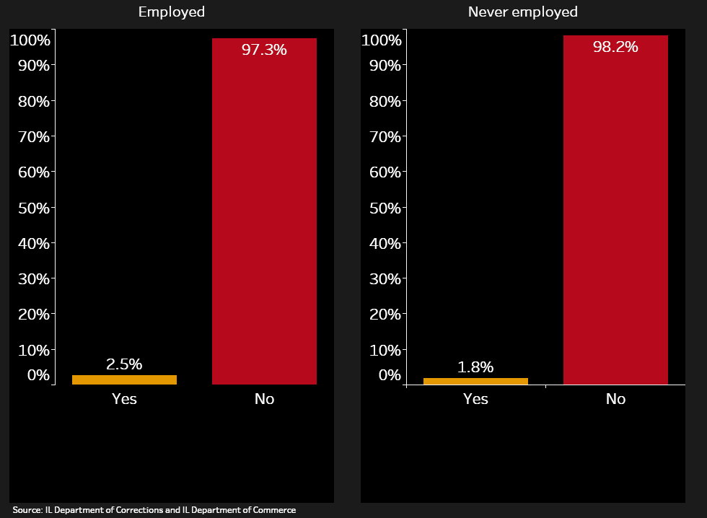
Heroin use more common in those not employed, marijuana and amphetamines more common for employed
Alcohol
Cocaine
Heroin
Marijuana
PCP
Amphetamines
Preliminary Draft - Do Not Cite
Notes:
Little variation between employed and unemployed prisoners for drug use.
Heroin slightly more common for prisoners not employed after release from prison
Marijuana and amphetamines more common for those who are employed after release from prison

Slide 20
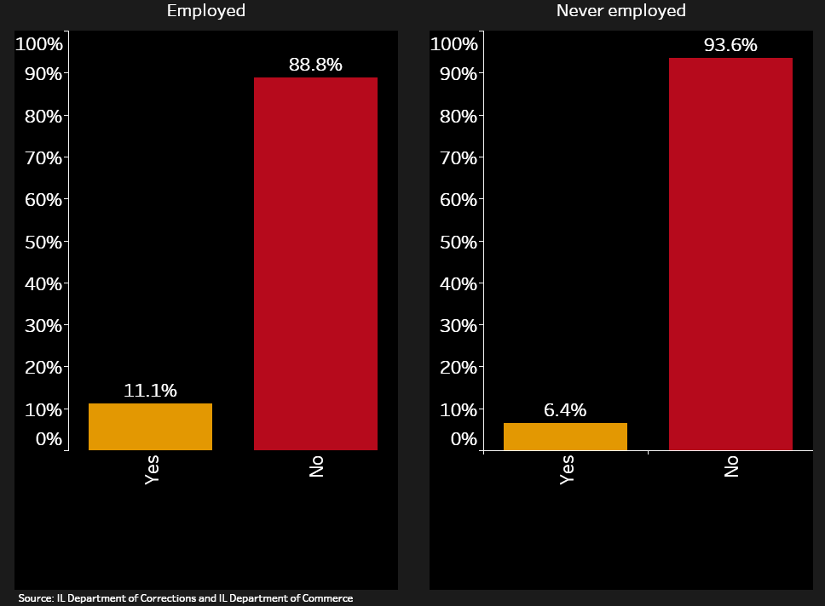
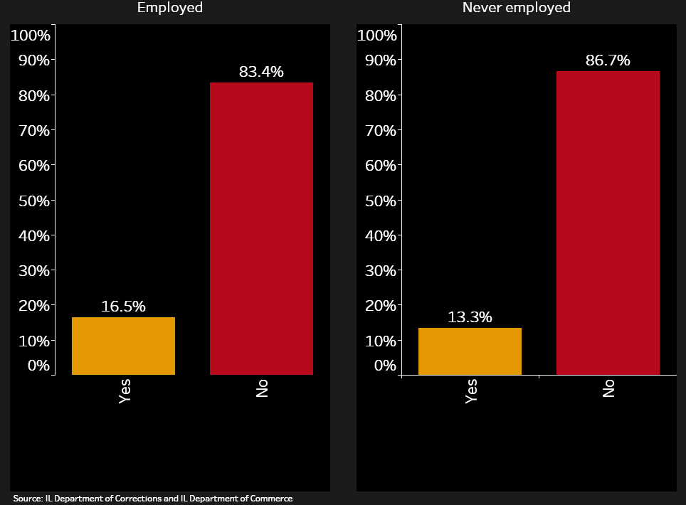
Employed former prisoners more likely to have received substance abuse treatment or education in prison
Substance abuse treatment
Education in prison
Preliminary Draft - Do Not Cite
Notes:
Prisoners receiving substance abuse treatment or education in prison more likely to be employed
Differences in the backgrounds of those who are employed or not suggests that we could predict employment after release from prison….

Slide 21
Research Question #3
Which prisoners should receive priority for interventions that can increase or enhance employment opportunities after release?
Preliminary Draft - Do Not Cite

Slide 22
Machine Learning Modelling
Never-employed (binary outcome) as function of individual characteristics
Two motivations
Who succeeds or fails in the legal labor market post-release? (Exploratory)
Can include features describing race/ethnicity
E.g., do different disparities persist across racial/ethnic groups?
What model best estimates the likelihood of success or failure when considering employment-focused interventions? (Prediction)
Best to exclude race/ethnicity (ethical and legal implications)
E.g., can observable prisoner characteristics inform program decisions?
Preliminary Draft - Do Not Cite

Slide 23

Machine Learning Modelling
Selected ML classifiers
Logistic regression
$y=Λ(α+β_{1}x_{1}+β_{2}x_{2}+…+β_{Kx_{K}}+ϵ)$
Explicitly specify structure of feature interactions
Random Forest
Ensemble classification method; independent bootstrapping; consecutive and independent (k-dimensional) linear splits of sample spaces
Flexible interactions. What are the most important features?
Gradient Boosting
Repeatedly fitting a tree to classification residual, each tree depends on past trees
Most Frequent Dummy
Assume everyone obtains the most common outcome (no one get’s a job)
Benchmark model
Preliminary Draft - Do Not Cite

Slide 24
Machine Learning Modelling
Assessing model performance
Four measures of classifier performance
Accuracy (percentage of outcomes correctly classified)
Precision (ratio of true positives to true and false positives)
Recall (ratio of true positives to true positives+false negatives )
ROC_AUC (Receiver Operating Characteristic_Area under the Curve; how much better or worse is the model doing compared to random assignment?)
Group K-fold cross-validation
Step 1: Train the classifier with 2011-2013 data, test the model with 2010
Step 2: Record model performance measures and model estimates
Step 3: Repeat steps 1 and 2 for each year having a turn to be the testing year
Step 4: Average measures across years
Preliminary Draft - Do Not Cite

Slide 25
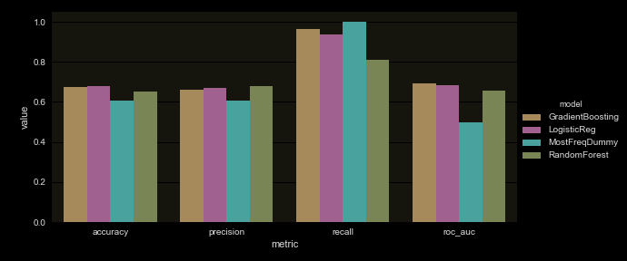
Model Performance
Group K-fold Cross-Validated Measures of Model
Performance for Each Selected Classifier
Preliminary Draft - Do Not Cite
Notes:
Our “smart” models do better than the chosen dummy benchmark. However, there isn’t much dramatic difference between LR, RF and GB. Still precision isn’t great and could be improved with smarter features beyond individual characteristics.
We COULD follow up this slide with the precision-recall curve to show that precision is decent if we only care about correctly classifying a small proportion of the population.

Slide 26
Relative Feature Importance
Most important features
Predicting being never-employed:
longer prison time
being older
having self-reported use of alcohol and some drugs (e.g., cocaine)
active gang member
Predicting being employed:
having employment prior to prison
having kids
receiving education in prison
Least important features
working in prison
receiving substance abuse treatment
having self-reported use of some drugs (e.g., PCP, amphetamines)
Preliminary Draft - Do Not Cite
Notes:
From Random Forest classifier
In essence, importance ~ height of the branch on the tree (not pictured)
Direction of association obtained from logistic regression results

Slide 27
Limitations
Wage limitations: no unofficial employment, no out of state, wrong SSN/duplicate issues by SSN
Quarterly wages (employment may vary within quarter)
DOC uses some of the information in the prediction models to assign people to job training programs which could introduce bias in the predictions
May not be valid for other states or other times
Preliminary Draft - Do Not Cite

Slide 28

Conclusions and Next Steps
Increasing employment after prison and targeting resources to increase employment can
Fulfill the goals of the DOC by reducing recidivism
Provide a better return on taxpayer money by targeting resources
Can reduce reliance on public assistance
Can improve the lives of former prisoners by generating income and enhancing social supports
Just under 40% of prisoners were ever employed over two years
Half of these prisoners were employed by the end of the first full quarter after release
More than 90% of prisoners were below poverty over two years
Compared to 14% in Illinois
Wages increased over the quarters but remained low
Preliminary Draft - Do Not Cite

Slide 29
Conclusions and Next Steps
Common classification techniques appear to be informative but perhaps more data beyond observed individual characteristics may be needed to increase precision
Next steps: merge employer data, type of job (industry), wages by industry, length of tenure at job, effect of employment on recidivism, additional geographic analysis
Preliminary Draft - Do Not Cite

